Slide 1
Calibration and Automation of a 5G Simulator for Realistic Evaluation and Data Generation
Conrado Boeira, Antor Hasan, Khaleda Papry, Yue Ju, Zhongwen Zhu, Israat Haque

Slide 2
Outline
5G Context
Motivation and Research Goals
Calibration Methodology and Results
Automation Tool
Demo
Conclusions
27 June 2024
Notes:
we have access to huge volume of data
5G architecture is complex
automation can reduce human error, opex and capex
Hard to directly utilize the actual deployment for testing

Slide 3
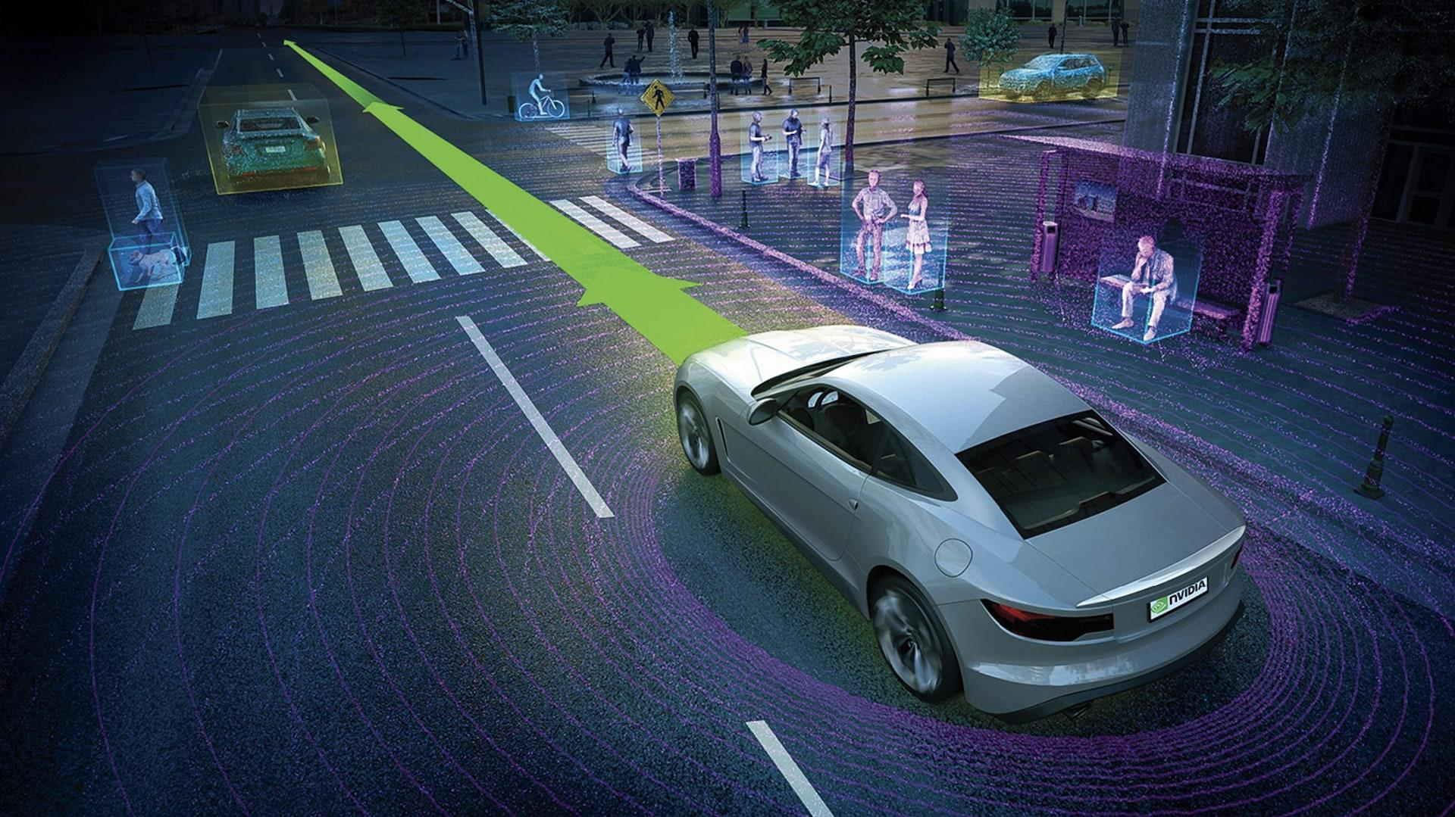
5G Deployment and Benefits
5G is already widely deployed
Supports emerging applications
Self-driving cars
AR/VR
Mobile gaming
Exponential traffic growth leads to more data-driven solutions
Automatic solutions reduce OPEX/CAPEX and human errors while offer fast responses
27 June 2024

Slide 4
Challenges in 5G Innovations
Complex architecture
Hard to configure and manage
Operators must test new functionalities with appropriate tunned parameters
Hard to test deployment feasibility
Hard to acquire data for data-driven solutions
Industries may not share their data due to business interests and privacy
Researchers may not have access to testbeds
27 June 2024
Notes:
we have access to huge volume of data
5G architecture is complex
automation can reduce human error, opex and capex
Hard to directly utilize the actual deployment for testing

Slide 5
What are the Alternatives?
We can use simulators to test new 5G functionalities
Allow for fast prototyping of ideas
Solves the lack of specialized datasets (e.g., anomalies)
Simulators must be trustworthy
They must be efficient to configure and use
27 June 2024
Notes:
we can generate anomalies as providers may not label failures, keep them for further analysis, or make it public [1]

Slide 6
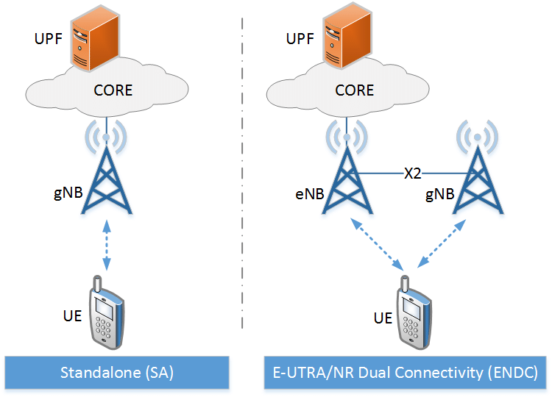
Research Objectives
Realistic and trustworthy simulation
Calibrate a simulator, Simu5G, to meet 3GPP standards
Learning curve reduction
Automate Simu5G configuration for better usability
Develop an automation tool for automatic configuration
27 June 2024

Slide 7
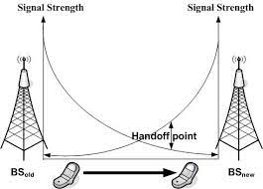
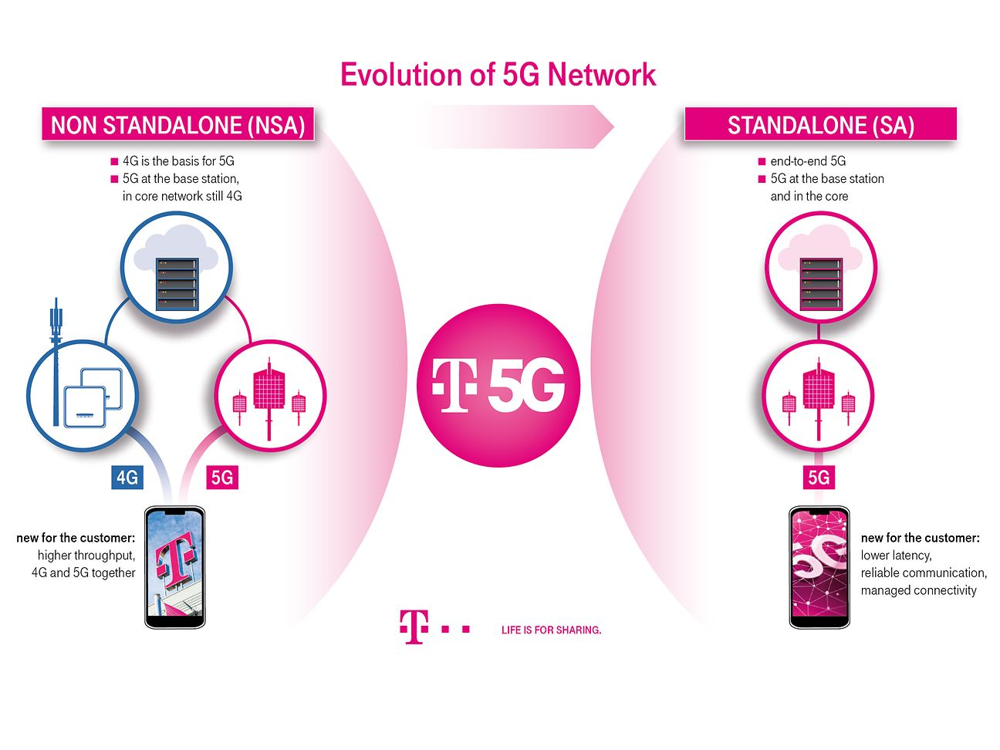
Why Simu5G?
Open source vs. proprietary simulators
5G-Lena [2], Simu5G [4] vs. WISE [3], NetSim [5]
Calibrated vs. uncalibrated
5G-Lena vs. Simu5G
Limitations of 5G-Lena:
Missing functionalities, e.g., handover
Do not support dual-connectivity
Simu5G:
Full stack simulator instead of focusing on a specific layer
Supports handover, dual-connectivity
27 June 2024

Slide 8
Methodology
3GPP created a standard scenario for calibrating and comparing simulators [6]
Each scenario has a predefined set of parameters
Recommend using the following two KPIs as calibration knobs
Coupling Gain: Difference between the signal strength at the source and destination of a communicating pair
Wideband SINR: Signal strength to noise plus interference ratio
Fine tune the simulator to match with 3GPP standards
Calibrated parameters that not defined by 3GPP
Performed an exhaustive search through the parameters to achieve the best result
27 June 2024

Slide 9
Implementation
Implemented a couple of use cases (e.g., eMBB-Urban and eMBB-Rural) for the calibration
Implemented the penetration loss and band usage following standards
Implemented the calibration KPIs (coupling gain, Wideband SINR) and their collection interface
Set relevant parameters following 3GPP, including missing ones
Thermal noise
User to base station distance
Building height
27 June 2024

Slide 10
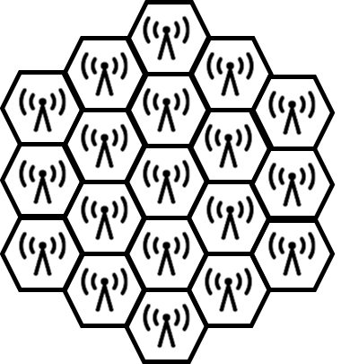
Evaluation Scenarios and Metric
Urban
Simulate a dense urban area
Shorter distance between gNBs (200m)
3GPP defined Urban path loss model
Rural
Simulate a sparse rural area
Larger distances between gNBs (1732m)
3GPP defined Rural path loss model
Metric: we calculate the CDF of coupling gain and SINR and compare against 3GPP provided CDFs
3GPP reference submissions include companies like Ericsson, Nokia
27 June 2024

Slide 11
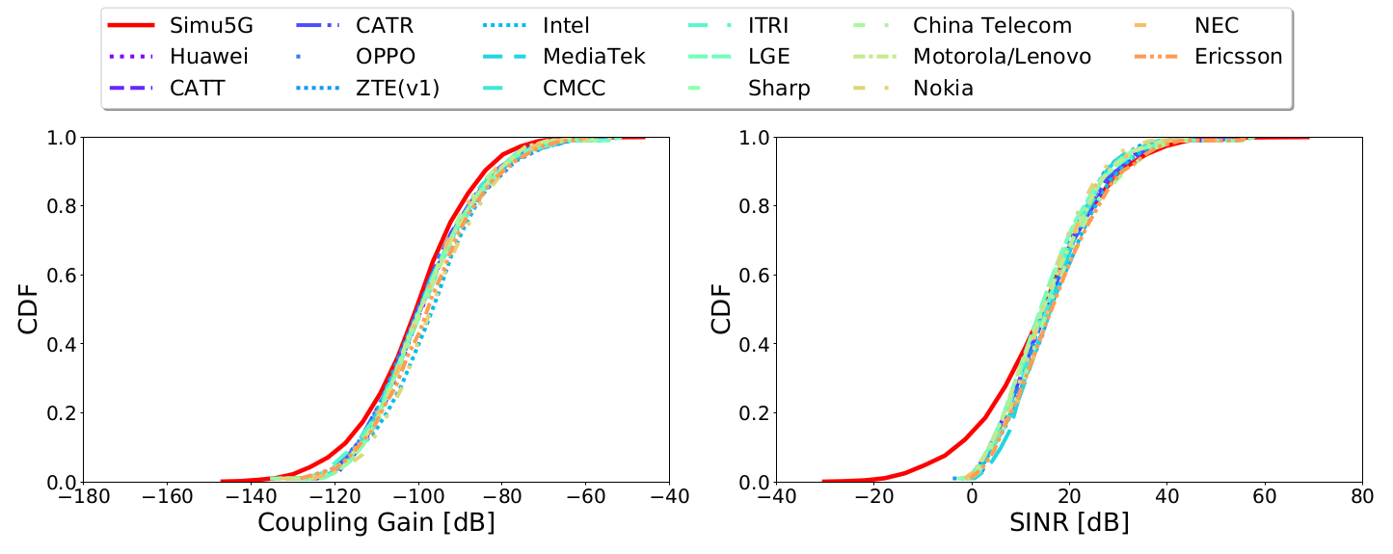
Results - Urban
In general, we observe a good match on median values
We observe a discrepancy in the lower end values
It is due to the lack of beamforming in Simu5G
27 June 2024

Slide 12
Results - Urban
In general, we observe a good match on median values
We observe a discrepancy in the lower end values
It is due to the lack of beamforming in Simu5G
27 June 2024

Slide 13
Results - Urban
In general, we observe a good match on median values
We observe a discrepancy in the lower end values
It is due to the lack of beamforming in Simu5G
27 June 2024

Slide 14
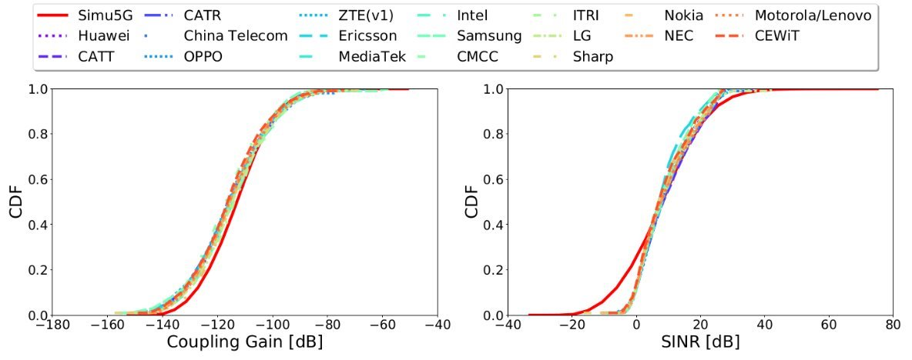
Results - Rural
Similar behavior as in Urban deployment
27 June 2024

Slide 15
Results - Rural
Similar behavior as in Urban deployment
27 June 2024

Slide 16
Results - Rural
Similar behavior as in Urban deployment
27 June 2024

Slide 17
Results – KS Test
Kolmogorov-Smirinov test attests the closeness of the curves
Similar performance trend as in CDF
Average discrepancy between Simu5G and 3GPP is below 2 dB
Within the acceptable range defined by 3GPP
27 June 2024
Notes:
.g., number of bands, device heights, thermal
noise levels, angle of transmissions, type of penetration losses

Slide 18
Automating the Simu5G Configuration
Different deployment scenarios require different parameters
urban, rural, indoor
Requires in-depth knowledge on 5G architectures and protocols
can be time consuming and error prone
Can we automate the simulator configuration process?
27 June 2024
Notes:
.g., number of bands, device heights, thermal
noise levels, angle of transmissions, type of penetration losses

Slide 19
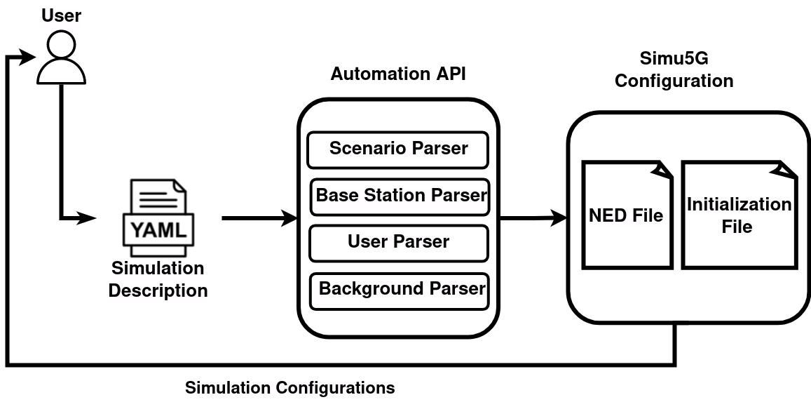
Automation Tool
We need two types of configurations in Simu5G
Initialization
Initial parameters (e.g., transmission power, frequency)
Network description (NED)
Topological configurations (e.g., number of devices)
User define high-level configuration information using a YAML file
Deployment scenarios, number of devices and their locations, KPIs to be collected, etc.
The tool follows 3GPP standards to configure the calibrated Simu5G
27 June 2024

Slide 20
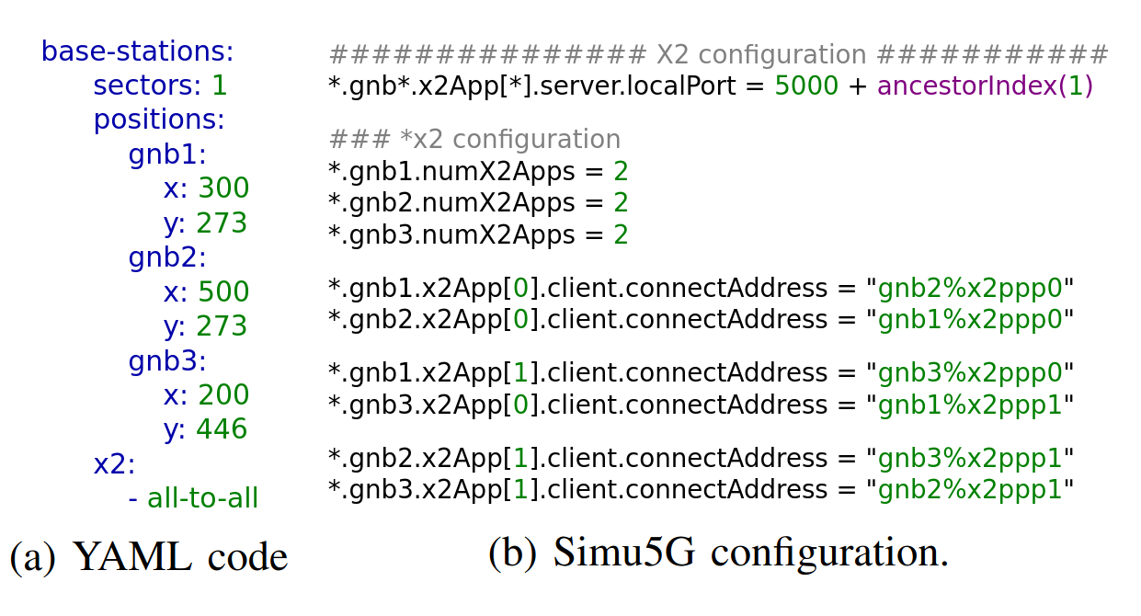
Results - Automation
1000 lines of code without using the proposed tool vs. ~100 lines with it
27 June 2024

Slide 21
Demo
27 June 2024

Slide 22
References
[1] M. Chen, K. Zhu, R. Wang, and D. Niyato, “Active learning-based fault diagnosis in self-organizing cellular networks,” IEEE Communications Letters, vol. 24, no. 8, pp. 1734–1737, 2020.
[2] Koutlia, Katerina, et al. "Calibration of the 5G-LENA system level simulator in 3GPP reference scenarios." Simulation Modelling Practice and Theory 119 (2022): 102580.
[3] Jao, Chin-Kuo, et al. "WiSE: a system-level simulator for 5G mobile networks." IEEE Wireless Communications 25.2 (2018): 4-7.
[4] Nardini, Giovanni, et al. "Simu5G–An OMNeT++ library for end-to-end performance evaluation of 5G networks." IEEE Access 8 (2020): 181176-181191.
[5] www.tetcos.com, “Netsim official developer,” https://www.tetcos.com/, 2018, [Online; accessed 25-March-2024].
[6] ITU-R, “Submission, evaluation process and consensus building for imt-
2020,” ITU-R IMT-2020/2-E, 2019.
[7] L. Rao et al., “5G beamforming techniques for the coverage of intended directions in modern wireless communication: in-depth review,” IJMWT, vol. 13, no. 10, 2021
27 June 2024

Slide 23
Acknowledgment
27 June 2024

Slide 24
Concluding Remarks
Calibrated Simu5G following 3GPP guidelines
To generate trustworthy and accurate data in Urban and Rural deployments
Introduced an API for automated configuration of Simu5G
Automatic generation of the necessary configuration files based on simpler parameters defined by the user
Contact:Conrado.boeira@dal.ca
27 June 2024

Slide 25
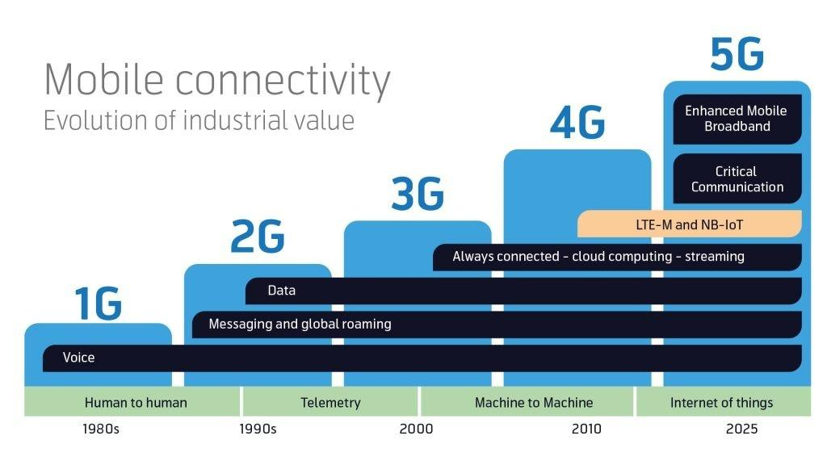
Evolution of Cellular Communications
Developments in cellular networks lead to constant innovation
5G is the newest step in this evolution
Higher bandwitdh
Lower Latency
Source: https://www.digitalmatter.com/5g-gps-trackers-cellular-iot
27 June 2024

Slide 26
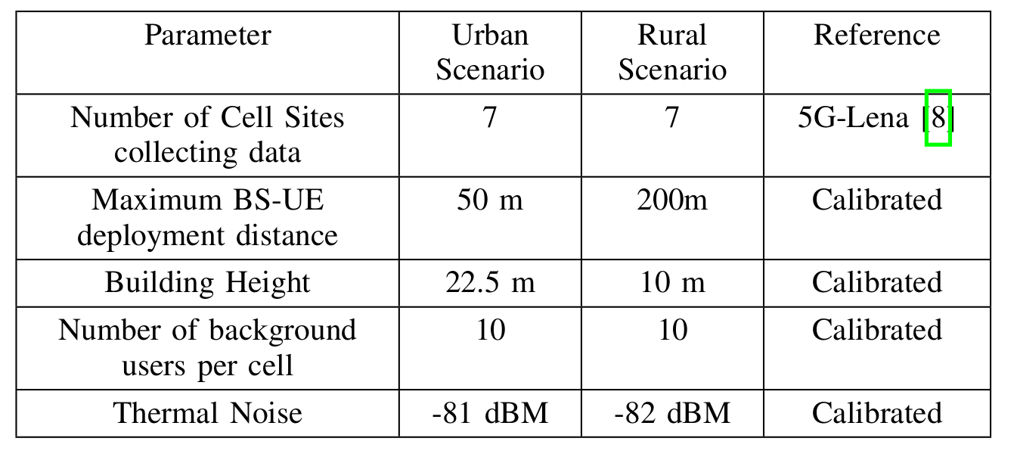
Calibrated Parameters
27 June 2024

Slide 27
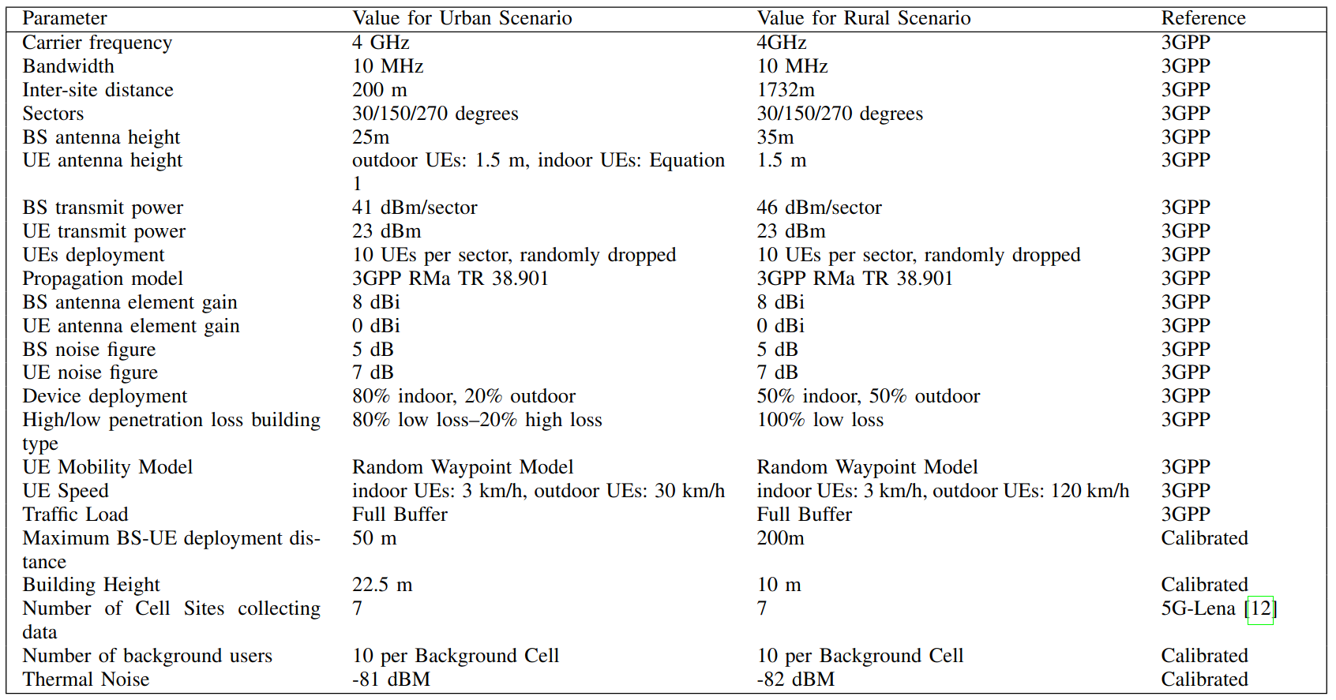
Full Scenario
27 June 2024

